Slide 1
Signal Processing and Feature Extraction Part-II
Muhammad Umar
Notes:
ID=d924773e-9a16-4d6d-9803-8cb819e99682 Recipe=text_billboard Type=TextOnly Variant=0 FamilyID=AccentBoxWalbaum_Zero

Slide 2
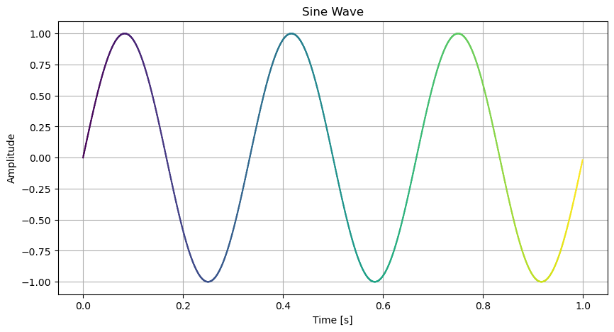
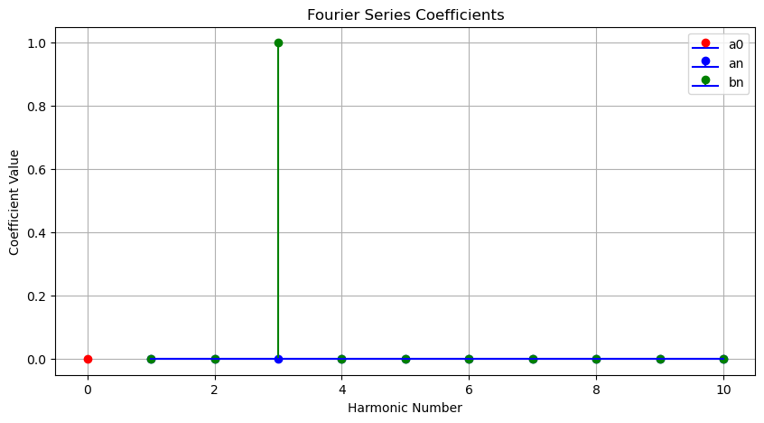
Signal Processing in the Frequency Domain
Extract important information
To compensate the shortcomings of signal processing in the time domain
Figure: Time Domain to Frequency Domain
2

Slide 3
Fourier Analysis Methods
Fourier Transform
Fourier Series (FS)
Fourier Integral Transform (FT)
Discrete Fourier Transform (DFT)
Fast Fourier Transform (FFT)
3

Slide 4
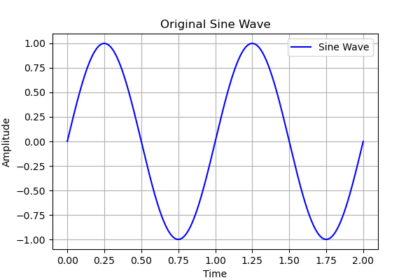
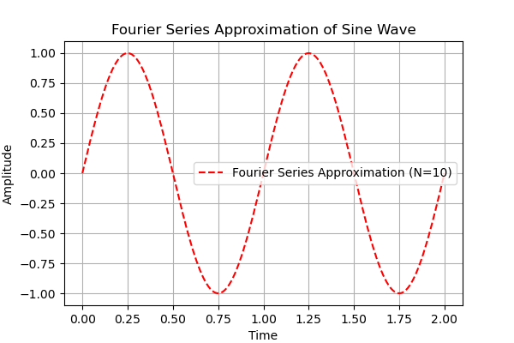

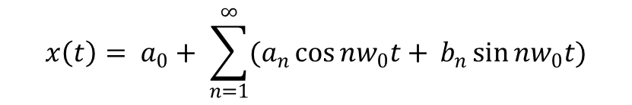
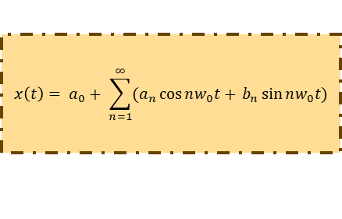
Fourier Series
FS converts periodic non sinusoidal signals into harmonically sinusoidal signals.
Fourier Series
Trigonometric Fourier Series
Exponential Fourier Series
$$x\left(t\right)= a_{0}+ \sum_{n=1}^{∞}{(a_{n}\cos{nw_{0}t+ }}b_{n}\sin{nw_{0}t)}$$
$$x\left(t\right)= \sum_{n= −∞}^{∞}{C_{n}e^{jnw_{0}t}}$$
Input
$$x\left(t\right)= a_{0}+ \sum_{n=1}^{∞}{(a_{n}\cos{nw_{0}t+ }}b_{n}\sin{nw_{0}t)}$$
Output
Figure: Fourier Series Visualization
4

Slide 5
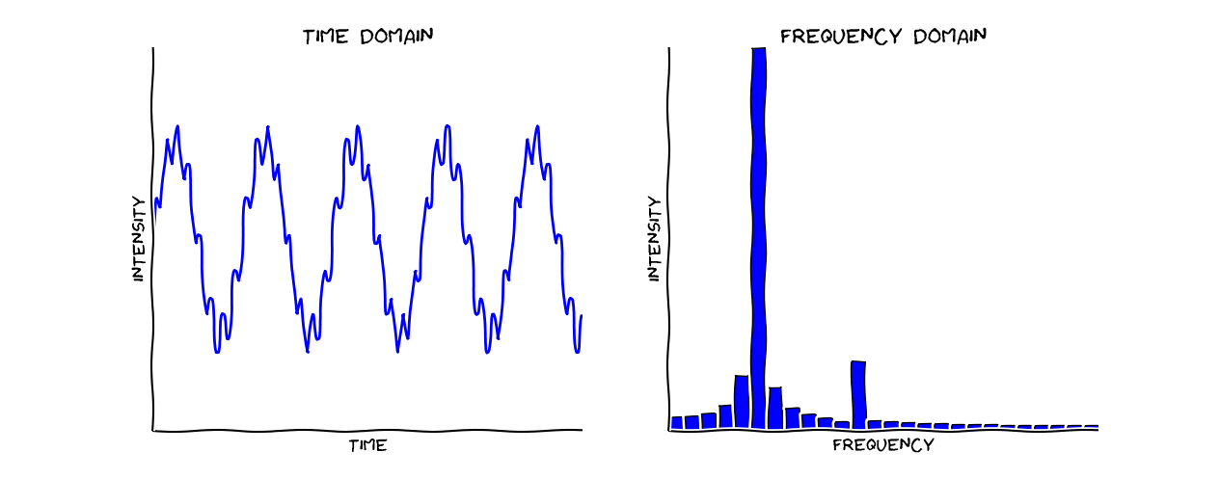
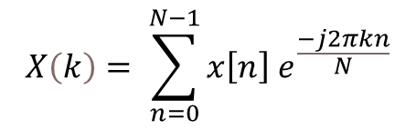
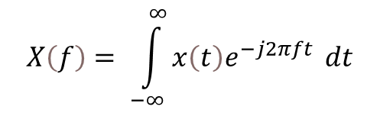
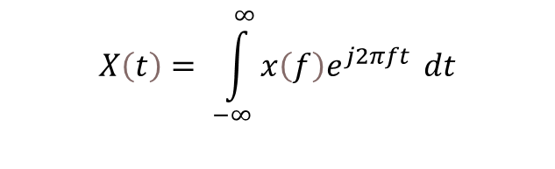
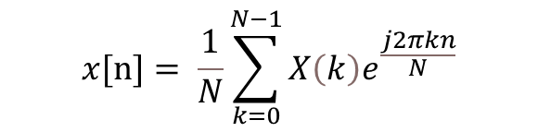
Fourier Transform
A mathematical transform which converts a time domain signal into frequency domain.
FT is applicable for both periodic and aperiodic signals.
Fourier Transform Equations
Forward Fourier Transform
Inverse Fourier Transform
$$X\left(f\right)= \int_{−∞}^{∞}{x\left(t\right)e^{−j2πft}} dt$$
$$X\left(t\right)= \int_{−∞}^{∞}{x\left(f\right)e^{j2πft}} dt$$
$$X\left(k\right)= \sum_{n=0}^{N−1}{x\left[n\right] e^{\frac{−j2πkn}{N}}}$$
$$x[n]= \frac{1}{N}\sum_{k=0}^{N−1}{X\left(k\right)e^{\frac{j2πkn}{N}}}$$
Figure: DFT Visualization
5

Slide 6
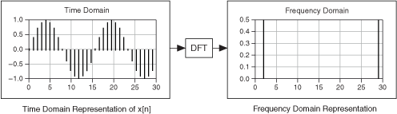


Discrete Fourier Transform
Discrete Fourier Transform analyze finite length signals in frequency domain.
Used for discrete signals, resulting in discrete frequency components
Forward DFT
Inverse DFT
$$X\left(k\right)= \sum_{n=0}^{N−1}{x\left[n\right] e^{−j\frac{2π}{N}kn}}$$
$$X\left(k\right)= \frac{1}{N}\sum_{n=0}^{N−1}{X\left(k\right)e^{j\frac{2π}{N}kn}}$$
Figure: Forward DFT Visualization
6

Slide 7
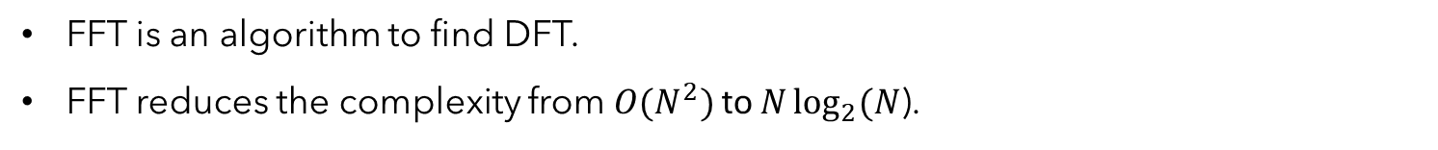
Fast Fourier Transform
FFT is an algorithm to find DFT.
FFT reduces the complexity from $O(N^{2})$ to $N\log_{2}{(N}$).
Figure: FFT Algorithm
7

Slide 8
Frequency Domain Features
Mean Frequency: Average amplitude of all frequencies
Variance: Spread of frequency spectrum
Skewness: Asymmetry in frequency spectrum
Kurtosis: Impulsiveness in spectrum
Frequency Center: Weighted center of frequency
Standard Deviation: Dispersion around the frequency center
Root Mean Square frequency: Energy of the frequency spectrum
Spectral Flatness: flatness of the spectrum
Energy Distribution: Distribution of energy
Relative Spread: Ratio of SD to frequency center, relative spread
Weighted Spread: Skewness of weighted frequency distribution
Weighted Kurtosis: Kurtosis of weighted frequency distribution
Half-Power Frequency Deviation: Deviation of power components
RMS Deviation: RMS deviation from frequency center
8

Slide 9
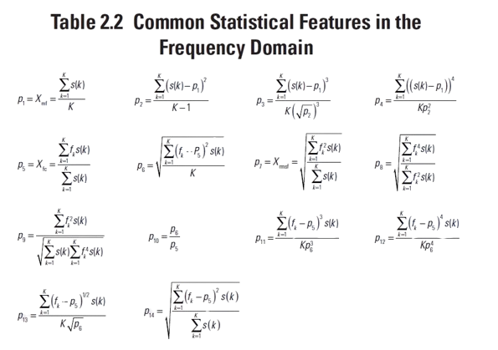
Cont.…
Table: Common Statistical Features in Frequency Domain
9

Slide 10
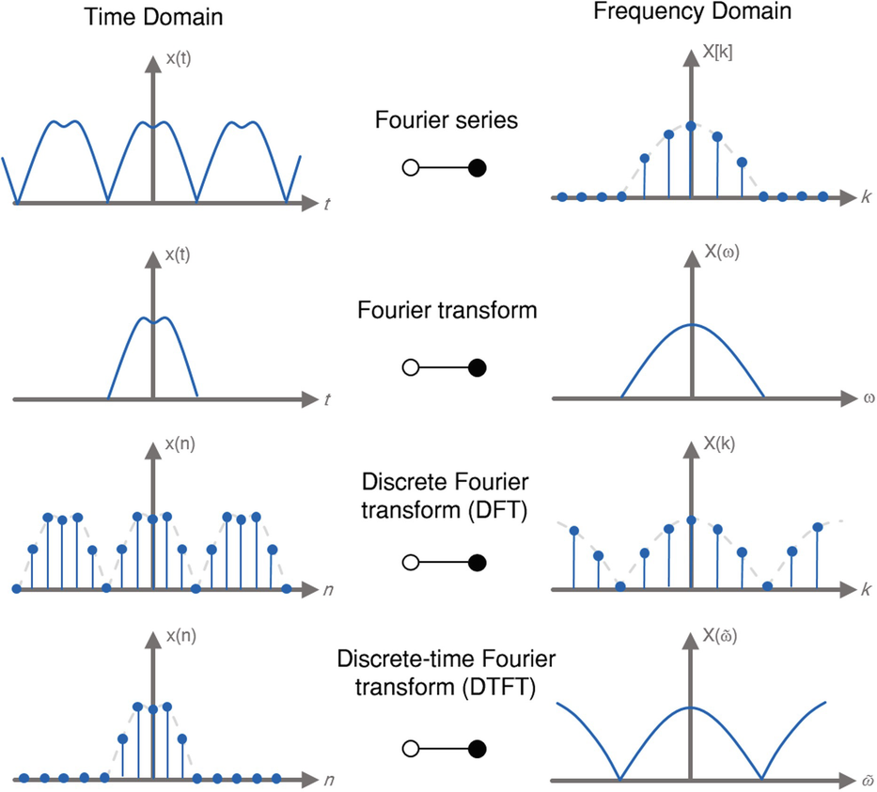
Summary
Fourier Series: Used for periodic signals, resulting in discrete frequency components.
Fourier Transform: Used for non-periodic signals, resulting in a continuous frequency spectrum.
Discrete Fourier Transform: Used for discrete signals, resulting in discrete frequency components.
Discrete-Time Fourier Transform: Used for discrete signals, resulting in a continuous frequency spectrum.
Figure: Signal Transformations
10

Slide 11


Thank You
Muhammad Umar
mmumar1758@gmail.com

